Slide 1
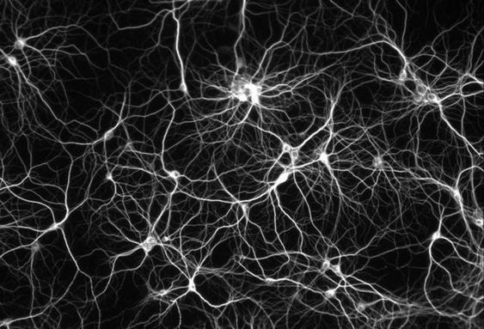
Exploring ANN-based Classification in Machine Learning
Presented by
Name –
Roll No. –
Dept. – CSE(AI & ML)
3rd year (5th semester)

Slide 2
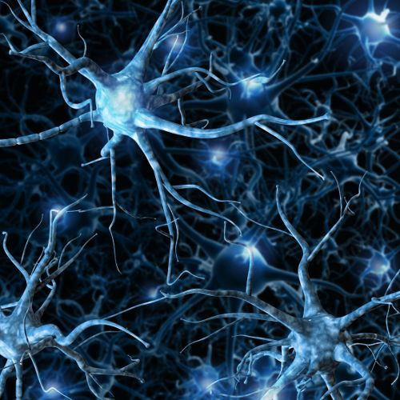
INTRODUCTION TO ANN
Artificial Neural Networks are the most popular machine learning algorithms today. The invention of these Neural Networks took place in the 1970s but they have achieved huge popularity due to the recent increase in computation power because of which they are now virtually everywhere.
Artificial Neural Networks are computational models inspired by the structure and functioning of the human brain.
Composed of interconnected nodes or neurons, ANNs can learn and generalize from data.
By simulating the brain's neural connections, ANNs are capable of performing complex tasks such as classification, pattern recognition, and more.
Artificial neural network (ANN) is a computational model that consists of several processing elements that receive inputs and deliver outputs based on their predefined activation functions.

Slide 3


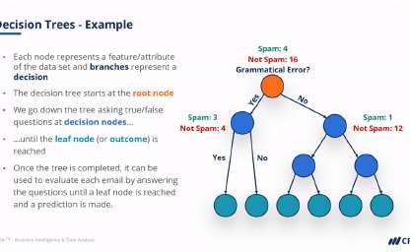
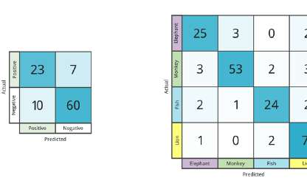
Supervised Learning for Classification
What is supervised learning?
Supervised learning is a machine learning technique where the algorithm is trained on labeled data. The algorithm learns from the labeled data and then tries to make predictions on new, unlabeled data.
What is classification?
Classification is a type of supervised learning where the algorithm learns to assign input data to one of several predefined categories. For example, classifying emails as spam or not spam.
Performance Metrics
Performance evaluation metrics such as confusion matrix, precision, recall, accuracy, and F1 score can be used to evaluate the algorithm's performance. These metrics help us determine the algorithm's accuracy, efficiency, and reliability
.

Slide 4
Types of ANN
1
Perceptron
The simplest type of ANN, consisting of a single layer of artificial neurons that process input data and produce an output..
Convolutional Neural Networks
(CNNs)
Commonly used in image and video recognition, CNNs consist of multiple layers, including convolutional layers and pooling layers..
2
3
Recurrent Neural Networks (RNNs)
RNNs are designed to process sequential data, such as text and speech, by taking the order of the data into account

Slide 5
Feedforward Neural Network
Structure of a Feedforward Neural Network
Feedforward neural networks are the simplest type of neural network and consist of an input layer, one or more hidden layers, and an output layer.
How it works
The input data is fed into the input layer, where it is processed and passed on to the hidden layer. The hidden layer processes the data further before passing it on to the output layer, which produces the results of the classification.
Limitations
Feedforward neural networks have limitations when it comes to dealing with complex and non-linear relationships in data. They also require a significant amount of data to function effectively

Slide 6
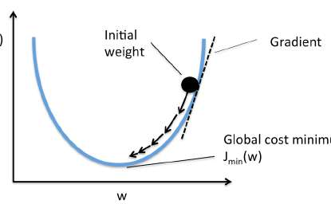
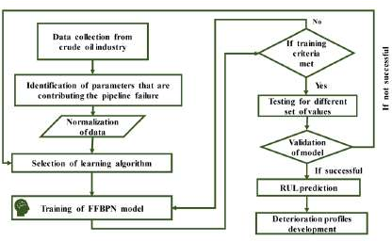
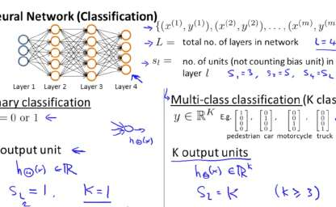
Backpropagation Algorithm
What is Backpropagation?
Backpropagation is an algorithm used to train artificial neural networks by adjusting the weights and biases of the connections between neurons.
How it Works
The backpropagation algorithm works by calculating the error between the predicted output and the actual output and then adjusting the weights and biases of the connections to reduce the error. This process is repeated for each input in the training set.
Cost Function
The cost function is used to measure how well the neural network is performing. The goal is to minimize the cost function by adjusting the weights and biases of the network

Slide 7

Training the Neural Network
Model Selection
The choice of neural network architecture is critical to the success of the algorithm. Factors to consider include the size of the network, the number of layers, and the activation function used.
1
2
3
Data Preprocessing
Data preprocessing is an important step in training the neural network. This involves cleaning and normalizing the data to ensure that it is in a format that can be used by the network.
Training and Validation
The network is trained on one part of the data and then validated on another part to tune the hyper parameters and prevent over fitting.

Slide 8
Performance Evaluation for Classification
Confusion Matrix
A confusion matrix is a table used to evaluate the performance of a classification algorithm. It shows the number of correct and incorrect predictions for each class.
Precision and Recall
Precision is the
number of true positives divided by the number of true positives plus false positives. Recall is the number of true positives divided by the number of true positives plus false negatives.
F1 Score
The F1 score is the harmonic mean of precision and recall. It is used to evaluate the overall performance of the classification algorithm.

Slide 9
APPLICATIONS OF ANN
Artificial Neural Networks find applications in various fields, including image recognition, natural language processing, financial forecasting, medical diagnosis, and recommendation systems. Their ability to handle large amounts of data and extract meaningful patterns makes them invaluable in solving real-world problems.
CHALLENGES AND LIMITATIONS
While ANNs have shown great promise, they also face challenges and limitations. Over fitting, computationally intensive training, and interpretability are some of the key issues. Understanding these challenges is crucial for effectively utilizing ANNs and addressing their limitations in practical applications

Slide 10
6. Conclusion
Artificial Neural Networks have revolutionized classification by leveraging their ability
to learn complex patterns and relationships. They have achieved remarkable success
in various domains, surpassing traditional classification algorithms ANN continue to
push the boundaries of classification accuracy and enable breakthroughs in
computer vision, natural language processing, and many other fields. Their potential
for further advancements is vast and promising.
THANK YOU!

